Slide 1

Plastic Injection Moulds
Plastic Injection Moulding
Product Designing
ARGUS POLYMERS
Complete Solutions in :

Slide 2
ARGUS POLYMERS
“Full-service” supplier of hi-quality moulds and tooling for plastic parts
Professional support in the design and construction of high-grade precision injection moulds at “best costs” and “short lead-time”
Integrated capabilities in mould design, prototyping, mould making, mould-trials/moulding and part-assembly.
We have the knowledge, experience, and facilities to manage every stage of your custom plastic injection-molding project

Slide 3
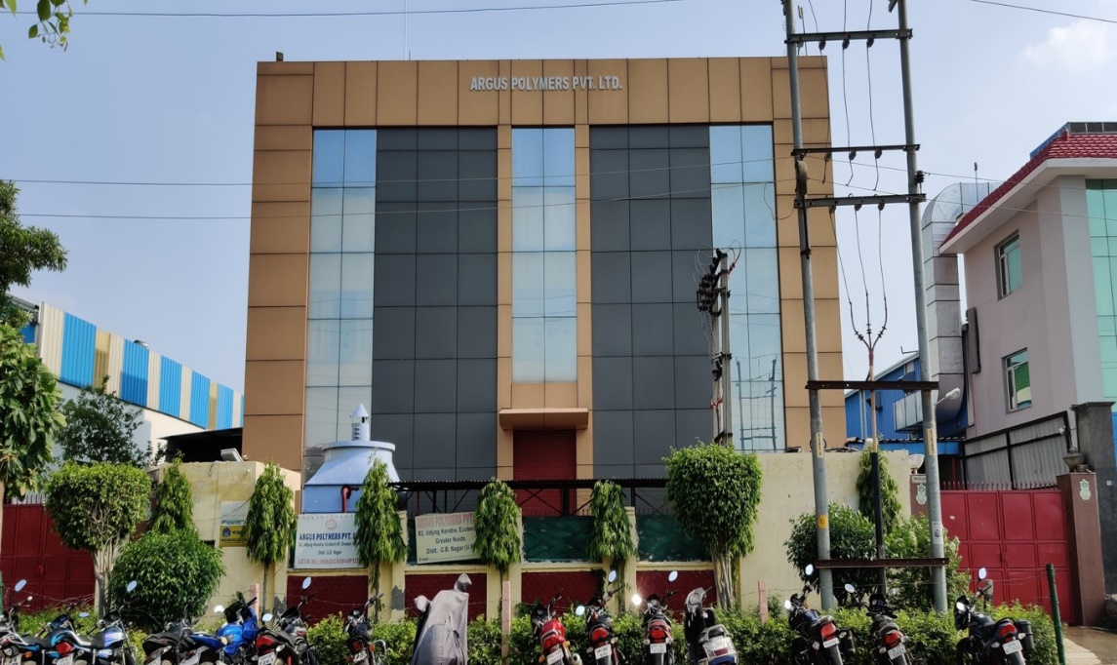
COMPANY PROFILE
Set up: 1989
Certification: ISO9001/14001
Factory area: 22000 sq. ft.
Employees: 125
Tooling Capacity: 80~100 moulds/year
3-shift-operation (6 days per week)
Location: 82, Udyog Kendra, Ecotech-III, Greater Noida, 201306

Slide 4
VISION
We are committed to the use of state-of-the-art technology in manufacturing the products, to maintain a fair business in our operation to meet our obligations, to sustain our growth and reach our goals.
We recognize the personal worth of employees by providing a framework that allows personal satisfaction, security and advancement opportunity.

Slide 5
WHAT ARGUS CAN OFFER
Plastic products of any type
International quality
On-time delivery
Competitive prices
Tool Development
Product Designing
Development of various type of Jigs & Fixtures

Slide 6
QUALITY CONTROL
Incoming quality control
Check steel hardness
Check machining accuracy
Check standard parts
Check samples
Check mold before shipment

Slide 7

QUALITY ASSURANCE
ISO 9001 : 2015 , ISO 14001 : 2015 certified
Formal quality systems to manage the overall quality process
Use precision measurement facilities by our well-trained team
All tooling and parts produced at our facility are constantly monitored by our Quality Assurance Department to meet your specifications including material, dimensional accuracy, surface finish, hardness, moulding standard, inspection, and packaging
Our quality systems are focused on the product and the customer all the times.

Slide 8
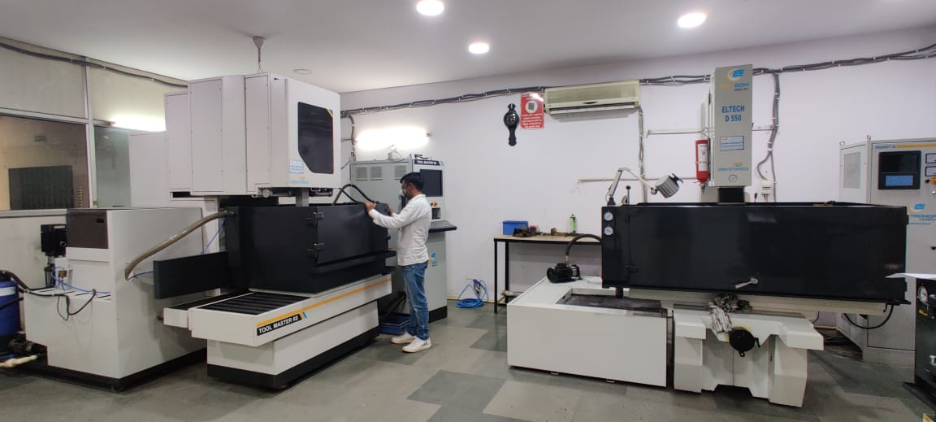
PRODUCT RANGE
Standard plastic injection moulds
Precision moulds with high tolerances
Multi-cavity moulds
Hot Runner moulds
Insert-moulds & Over-moulds
Molds for Chrome-plating parts
Thermo Plastic Moulded components

Slide 9
MACHINES (TOOL ROOM)
TYPES | Nos.
CNC Milling (VMC-Hartford) 800 | 2
CNC Milling (VMC-Hartford) 1270 | 1
CNC Wirecut 600*400 (Submerged Electronica) | 1
CNC Wirecut 400*300 (Sprintcut Electronica) | 1
CNC EDM (Electronica) | 1
ZNC EDM (Electronica) | 6
Milling Machine | 3
Lathe Machine | 1
Surface Grinder Machine | 4
Drilling Machine | 2

Slide 10
MOULD DEVELOPMENT PROCESS
PHASE 0
PROJECT INITITAION
PHASE 1
CONCEPT DEFINATION
PHASE 02
DEVELOPMENT
Concept idea
Feasibility study
Cost targets
Quotation
Project start
Mould design
Mould-flow analysis
2D/3D drawings
Mould building
Milling/Wire-cut
CNC/EDM/Polish
Assembly
MOULD IDEAS
RFQ
Product type
Material type
Lifetime
Production volume
Number of Cavity
Moulding place
Cycle time
PHASE 3
VALIDATION
PHASE 04
PRODUCTION LAUNCH
Mould trial & improve
Full dimension check
Moulding conditions
ISIR report
Injection moulding
production
CONTINUOUS IMPROVEMENT & SERVICES
TECHNICAL SUPPORT

Slide 11
DESIGN AND ENGINEERING
Feasibility Study (DFM), product improvement proposal
Complete in-house design, 2D and 3D design approval before cutting steel
Mould flow analysis on requirement (outsourced)
CAD/CAE/CAM software: Solid works/Delcom/ etc.
Technical discussion with PPT reports
Recently we undertook a designing and R&D Startup under the name M/s Morphedo Technologies Pvt. Ltd. which specializes in providing Innovation as a Service (www.morphedo.com).

Slide 12
MOULD DESIGN
Mould
life
Mould
material
Cost
restraints
Moulding
machine
Mould
Design
Component
detail
Quantity
Component
material
Mould
making
techniques
Post
moulding
operations

Slide 13
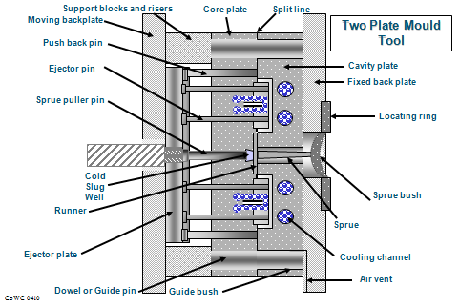
TWO PLATE MOULD TOOL

Slide 14
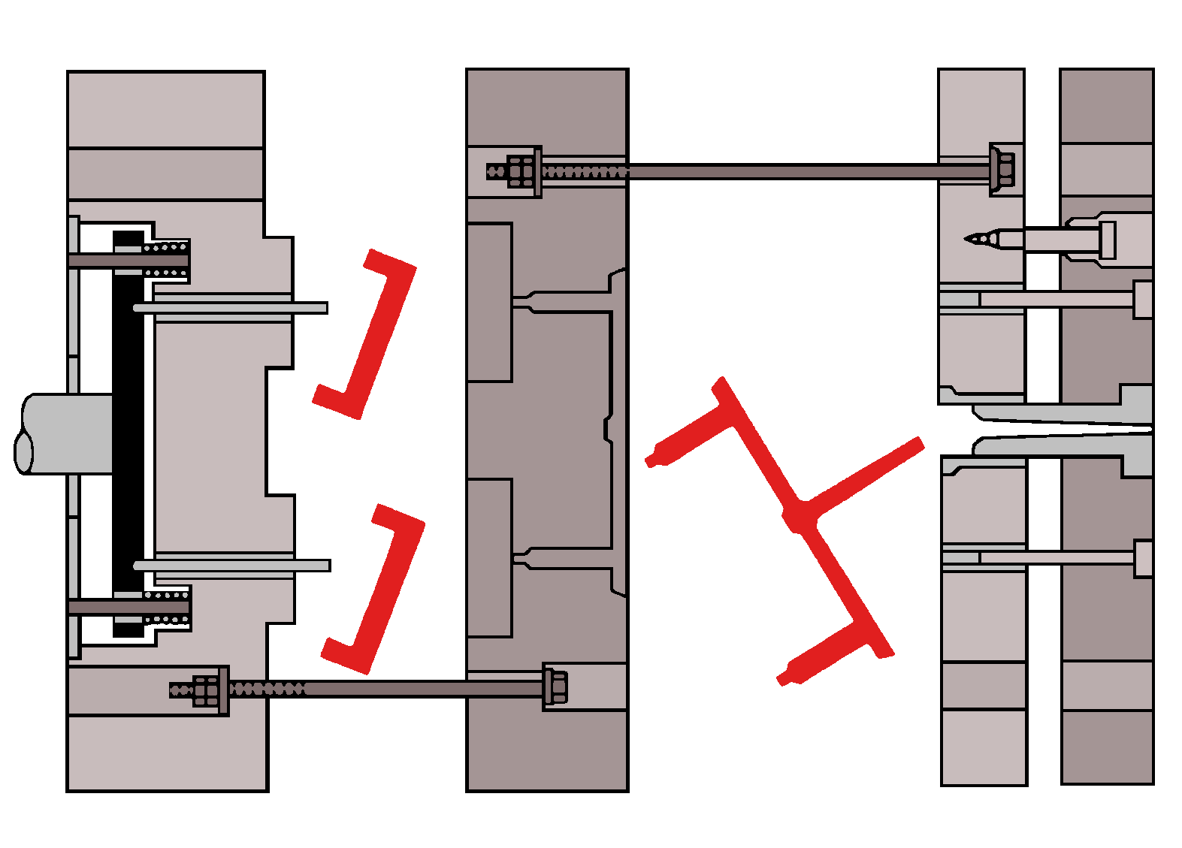
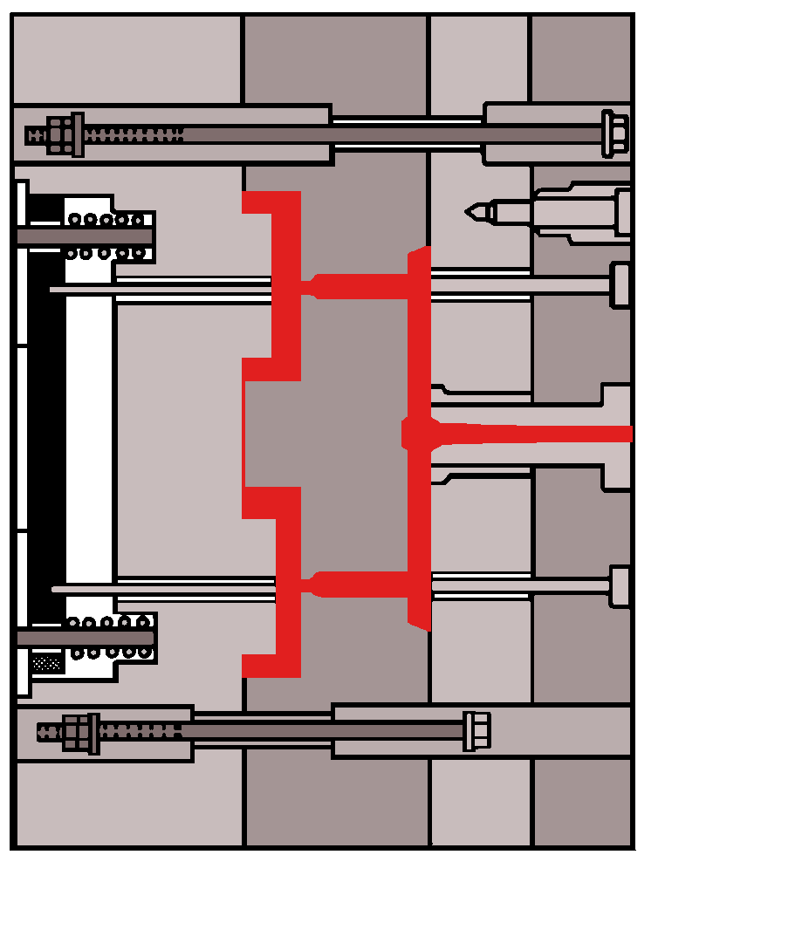
MULTI PLATE MOULD TOOL

Slide 15
HOT RUNNER
Hot runner System contain Manifold,
Hot tip Nozzle & Temperature controller.
Various type of hot runner system is Semi
Hot runner System and Fully hot runner
system.
Semi Hot runner system contain
one drop for two cavity / four cavity
and applicable for multiple cavity
mould. Fully hot runners are each
cavity contains individual hot tip nozzle
as it is absolutely fully automatic,

Slide 16
FEATURES OF HOT RUNNER
Avoid runner in mould,
Increasing productivity by reduce cycle time.
Best Quality in product & best competitive prices. High availability for abrasive and aggressive materials
International Standardization and Quality
Easy assembly and quality checking between hot runner system and mould
Applied to single / multi products moulds
Easy colour-change.
Smooth gate mark(s).

Slide 17
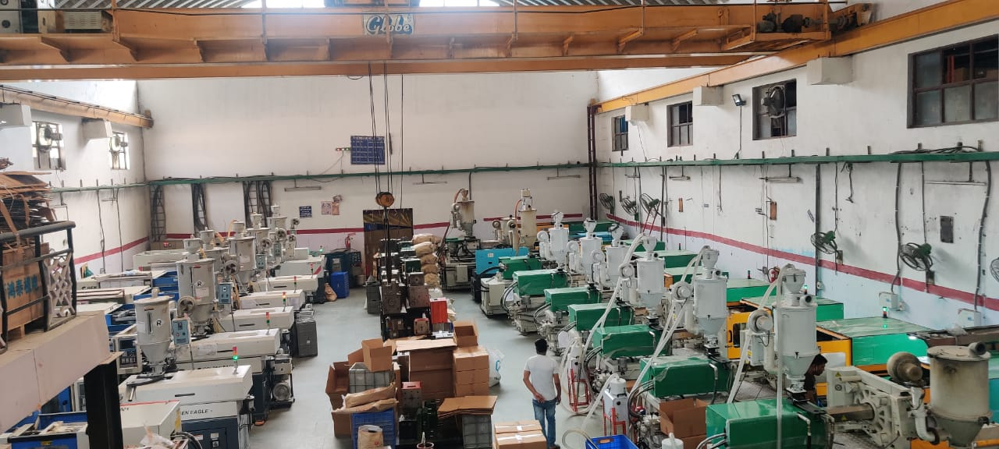
MOULDING PRODUCTION
Common material used for moulding:
  ABS, PC, PS, PMMA, PP, PA6, PA66, PBT, PPS, POM, TPE , HIPS, etc.
In-house Molding/Trials
  Dimensional reports for the samples
  Final mould trial parameters
  4-hour continuous mould running upon request
  Provision for samples upon each mould trial
  Mould trial video on request

Slide 18
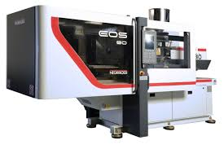
MOULDING
Our moulding machines range from 50 tons to 450 tons which means we can run virtually any mould tool you may be currently placing elsewhere. A large number of moulding machines, combined with a 24 hour per day manufacturing operation, enable us to confidently offer reduced lead times and faster deliveries to you.

Slide 19
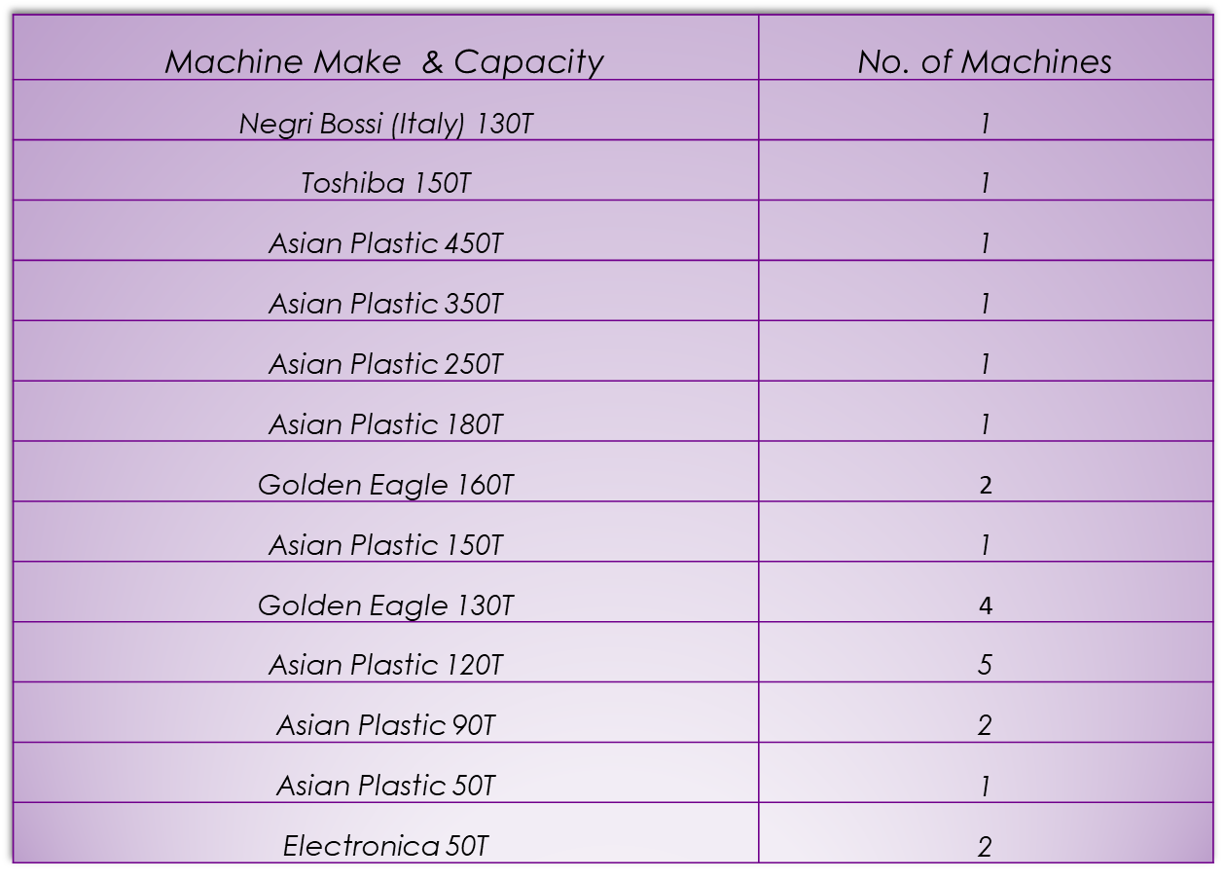
MACHINES (MOULDING)

Slide 20
























Major Clients

Slide 21
ZERO DEFECT POLICY
Eliminate
bad designs
Eliminate bad
components
Eliminate bad
manufacturing
Eliminate non- conforming products
ZERO
DEFECT
Mould Design
System
Use standard
components
Advanced
equipment
& skilled staff
Quality Assurance
System

Slide 22
WHY ARGUS
We bring to you:
Over 30 years of experience in manufacturing of tooling and OEM Mechanical products.
Proven performance track record, product / mould design support for cost-reductions, not just “Unit Cost” but “Total Cost of Ownership”.
Complete Solution: Our tools are 100% finished, fully optimized for part quality, process and cycle time.

Slide 23

THANK YOU

